Slide 1
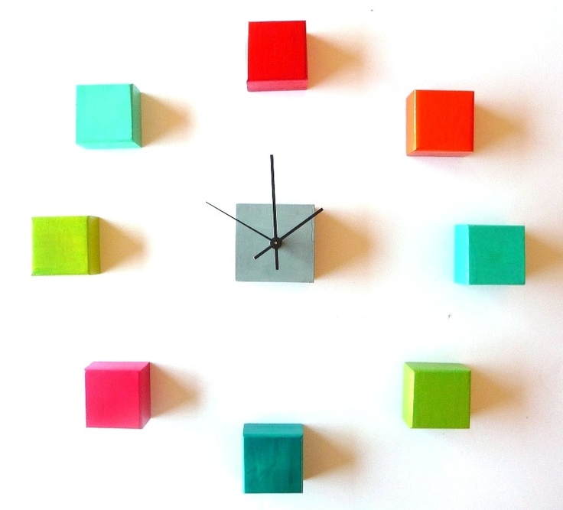
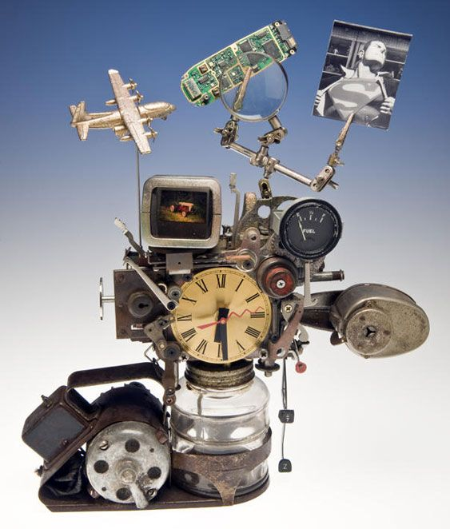
Creative Clocks
Sculpture Class 2014

Slide 2
Your Task…
Is to design an all new functioning clock.

Slide 3
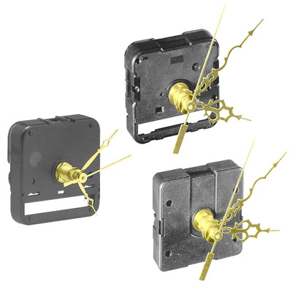
You are given the clock mechanism….
And need to use it in a creative fashion, using any material you like! The only limitation is your imagination.

Slide 4
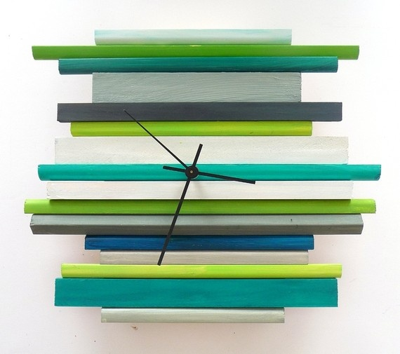
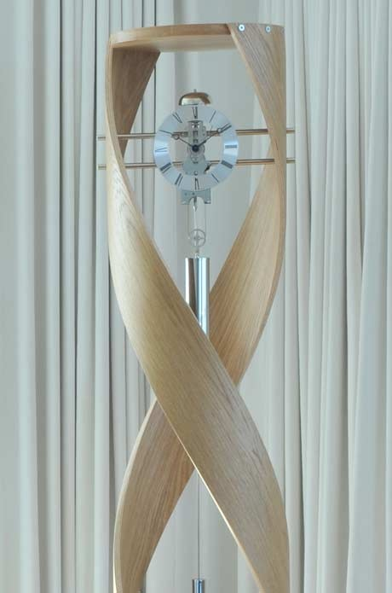
What can I use?
Wood (Pre-cut or scrap), Trees or Sticks

Slide 5
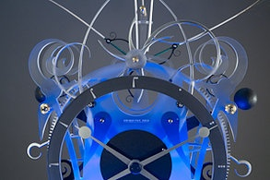
Metal / Wire
Keep in mind….I have wire, but not sheets of metal. How will you attach the wire or metal?

Slide 6
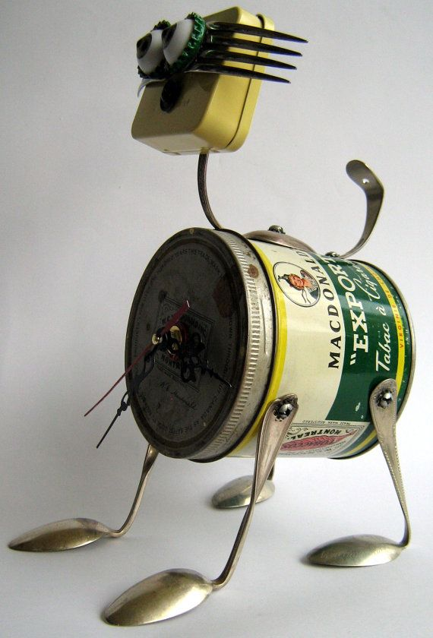
Found Objects
What objects are the above images made from?
Notice the craftsmanship (How neatly they were constructed)!

Slide 7
Could you use clay?
* There’s one BIG issue with clay.
It needs to be sculpted, then fired, then finished.
A very long process!
* It can also break easily before its fired!!
How about air dry clay or Crayola Model Magic?

Slide 8
The Possibilities are Endless!!

Slide 9
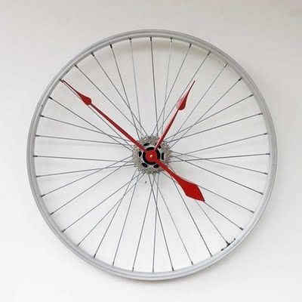
Make it a decent size…
Nothing too small!

Slide 10
Other Things to Think About…
* Color
* Design
* Interesting
* Uniqueness

Slide 11
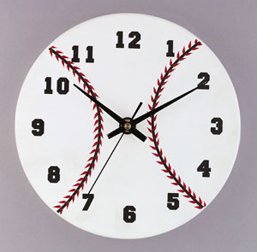
Where to start?
Think of a theme or object that you enjoy…. Animals, Sports, Music, etc.

Slide 12
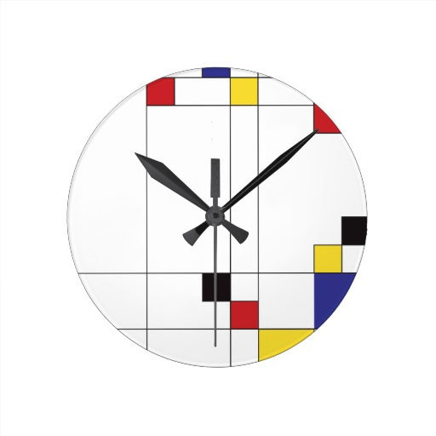
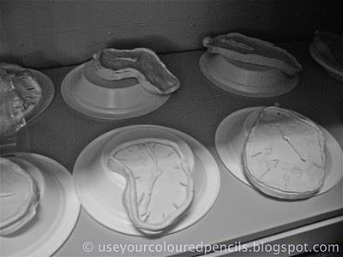
Still Stuck?
Work with an artist. Below is examples for…
Piet Modrian Salvador Dali

Slide 13
How are You Graded?
Sketches = At least 3, with your thoughts and ideas on them.
Creativity = Did you think “outside the box” to complete your idea.
Uniqueness = How different is your idea from everyone elses.
Aesthetics = How it looks overall. Does it capture the eye of your viewer?
Effort = Did you work hard in class? Did you spend time outside of class working on this as well?
Craftsmanship = How neatly/skillfully finished your piece is.
Eg. No glue showing, skillfully cut, no sharp edges, etc.

