Slide 1
Altered Books
Sculpture 1

Slide 2
What do you normally use a book for?

Slide 3
Lets change that!

Slide 4
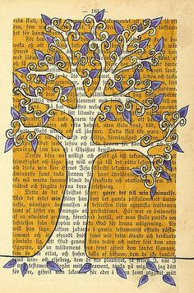
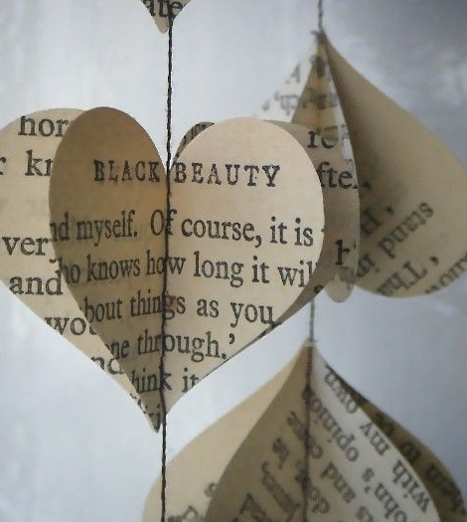
Some simple things to do with paper

Slide 5
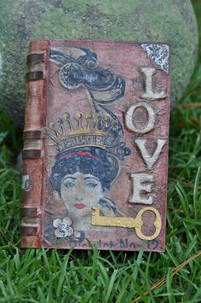
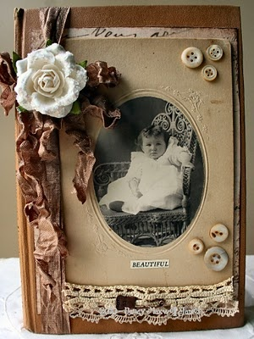
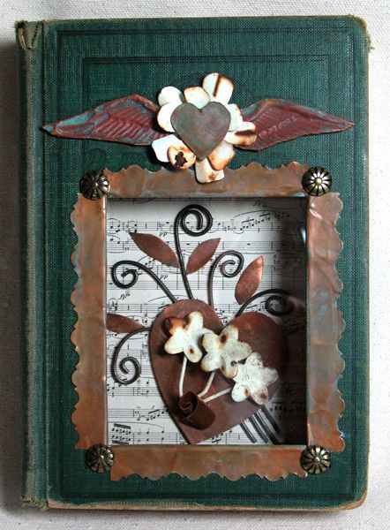
You can change the cover…

Slide 6
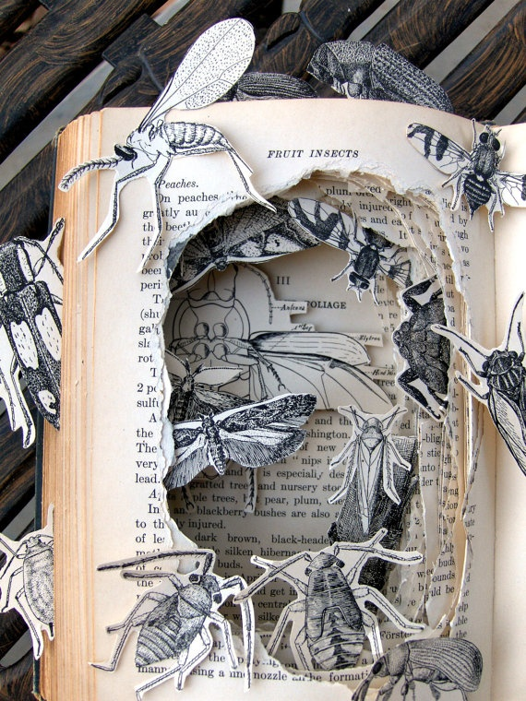
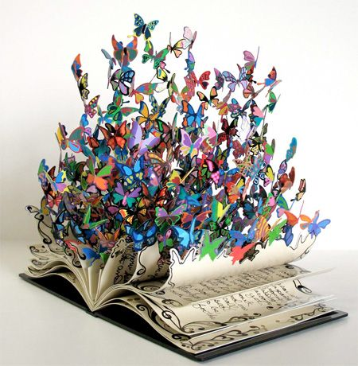
You can cut pages…

Slide 7
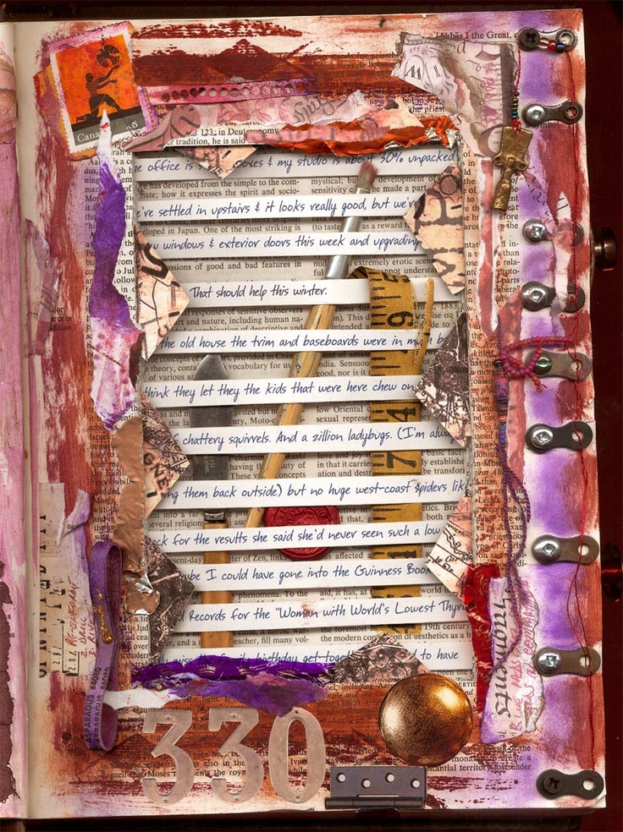
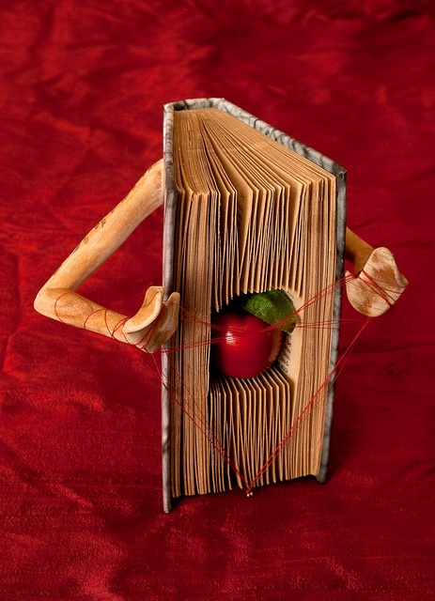
More examples of cutting..

Slide 8
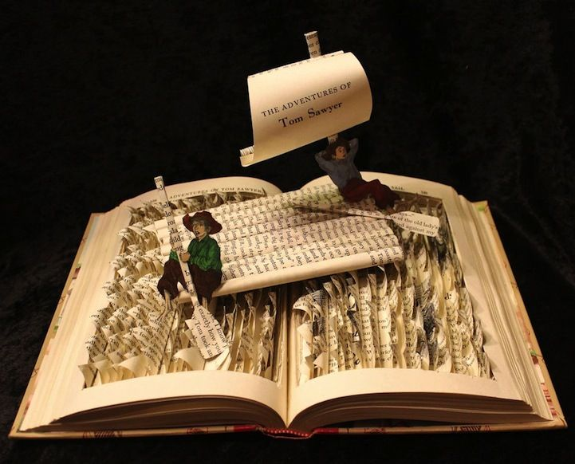
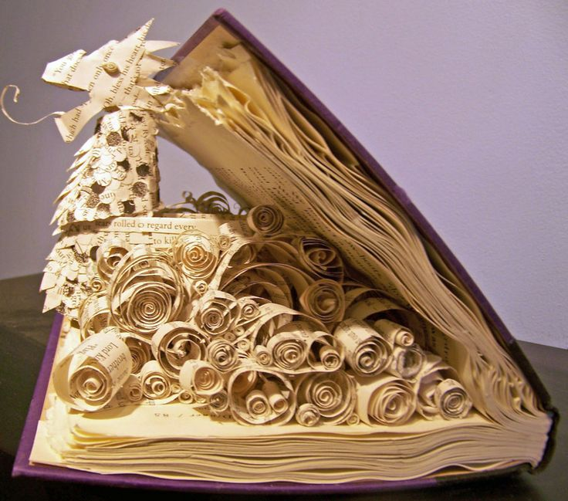
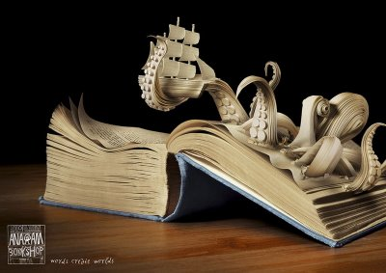
Some other amazing books!

Slide 9
What do you need to do next?
Collect 10 different objects from the table.
- One person goes and gathers one item
You need to find a book that you would
like to use.
Use at least 7 of the objects within you book along with anything else you like!

Slide 10
How are YOU graded?

