Slide 1
Seeing Is Believing
Foundations of Art

Slide 2
The following slides will test your visual ability
Please write your name down on the sheet of paper and answer the following questions.
Remember there are no wrong answers for this, so you won’t need to change your answers.
This will be your exit ticket for today!

Slide 3
1. What does this logo say?

Slide 4
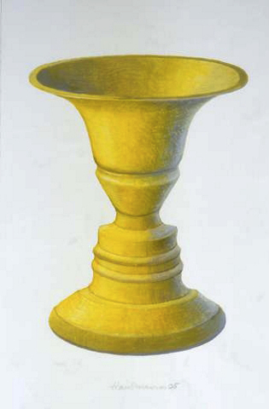
2. What is the object below?

Slide 5
3. Which animals do you see below?

Slide 6
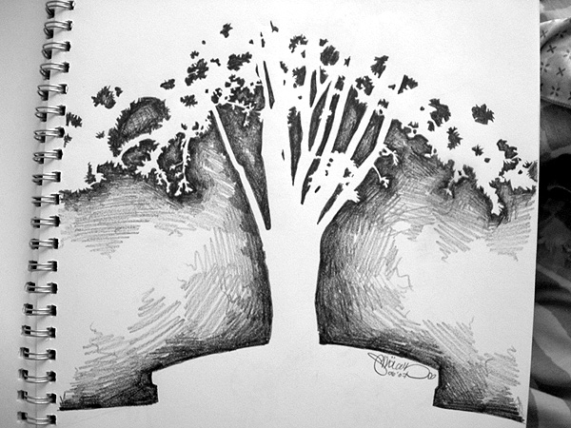
4. What do you see below?

Slide 7
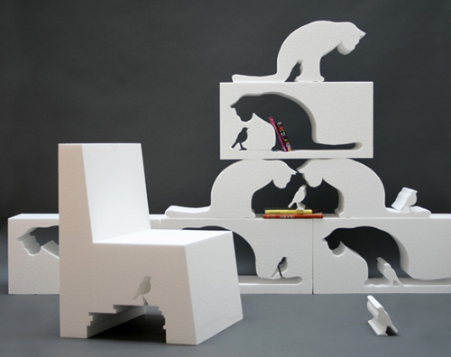
5. How many cats do you see?

Slide 8
6. What do you see in the image below?

Slide 9
7. What do you see in this image?

Slide 10
8. Which letters do you see below?

Slide 11
9. What do you see in this image?

Slide 12
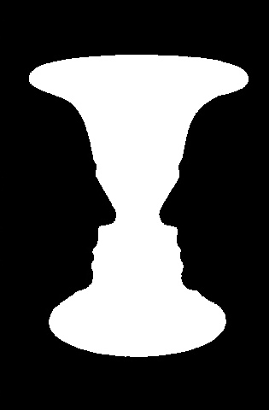
10. What do you see below?

Slide 13
The following has been an introduction to the use of positive and negative space.

